Slide 1


Data Engineer Jobs

Slide 2
Obtaining the data
Scraped from glassdoor (platform for job searching)
Found on Kaggle

Slide 3
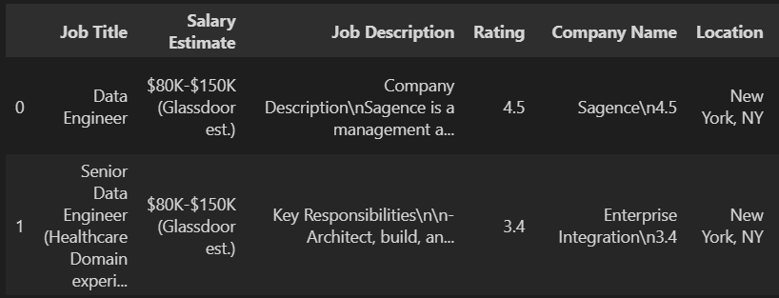
Data

Slide 4
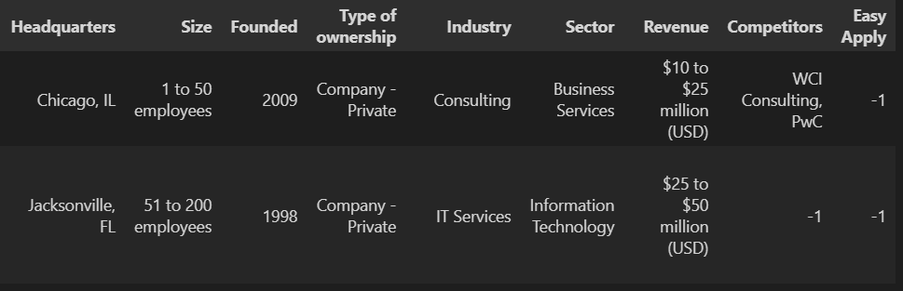

Slide 5
Sources
https://www.kaggle.com/datasets/andrewmvd/data-engineer-jobs

